Slide 1


Microsoft Stream on SharePoint unwrapped
#CollabDaysBE
Maarten Eekels | @maarteneekels
CollabDays Belgium 2022 by BIWUG

Slide 3

Maarten eekels
CTO @ Rapid Circle
Board member Dutch Information Workers User Group (DIWUG)
Microsoft MVP
Microsoft Regional Director
Passionate cyclist
Certified wine sommelier
@maarteneekels

Slide 4
Why video?
Over 500 million (half a BILLION) people are watching video on Facebook every day (Forbes)
In the past 30 days, more online video content has been uploaded to the web than the past 30 years of TV content. (Blue Corona)
Viewers retain 95% of a message when they watch it in a video, compared to 10% when reading it in text. (Wirebuzz)

Slide 5
Why video?
According to Statistic Brain Research Institute:
The average attention span of a human is 8s
The average attention span of a gold fish is 9s

Slide 6

Why video?
Communication
New products
Education
Collaboration
Changes
Onboarding
Training
Best practices
Corporate messages
How to
Community

Slide 7
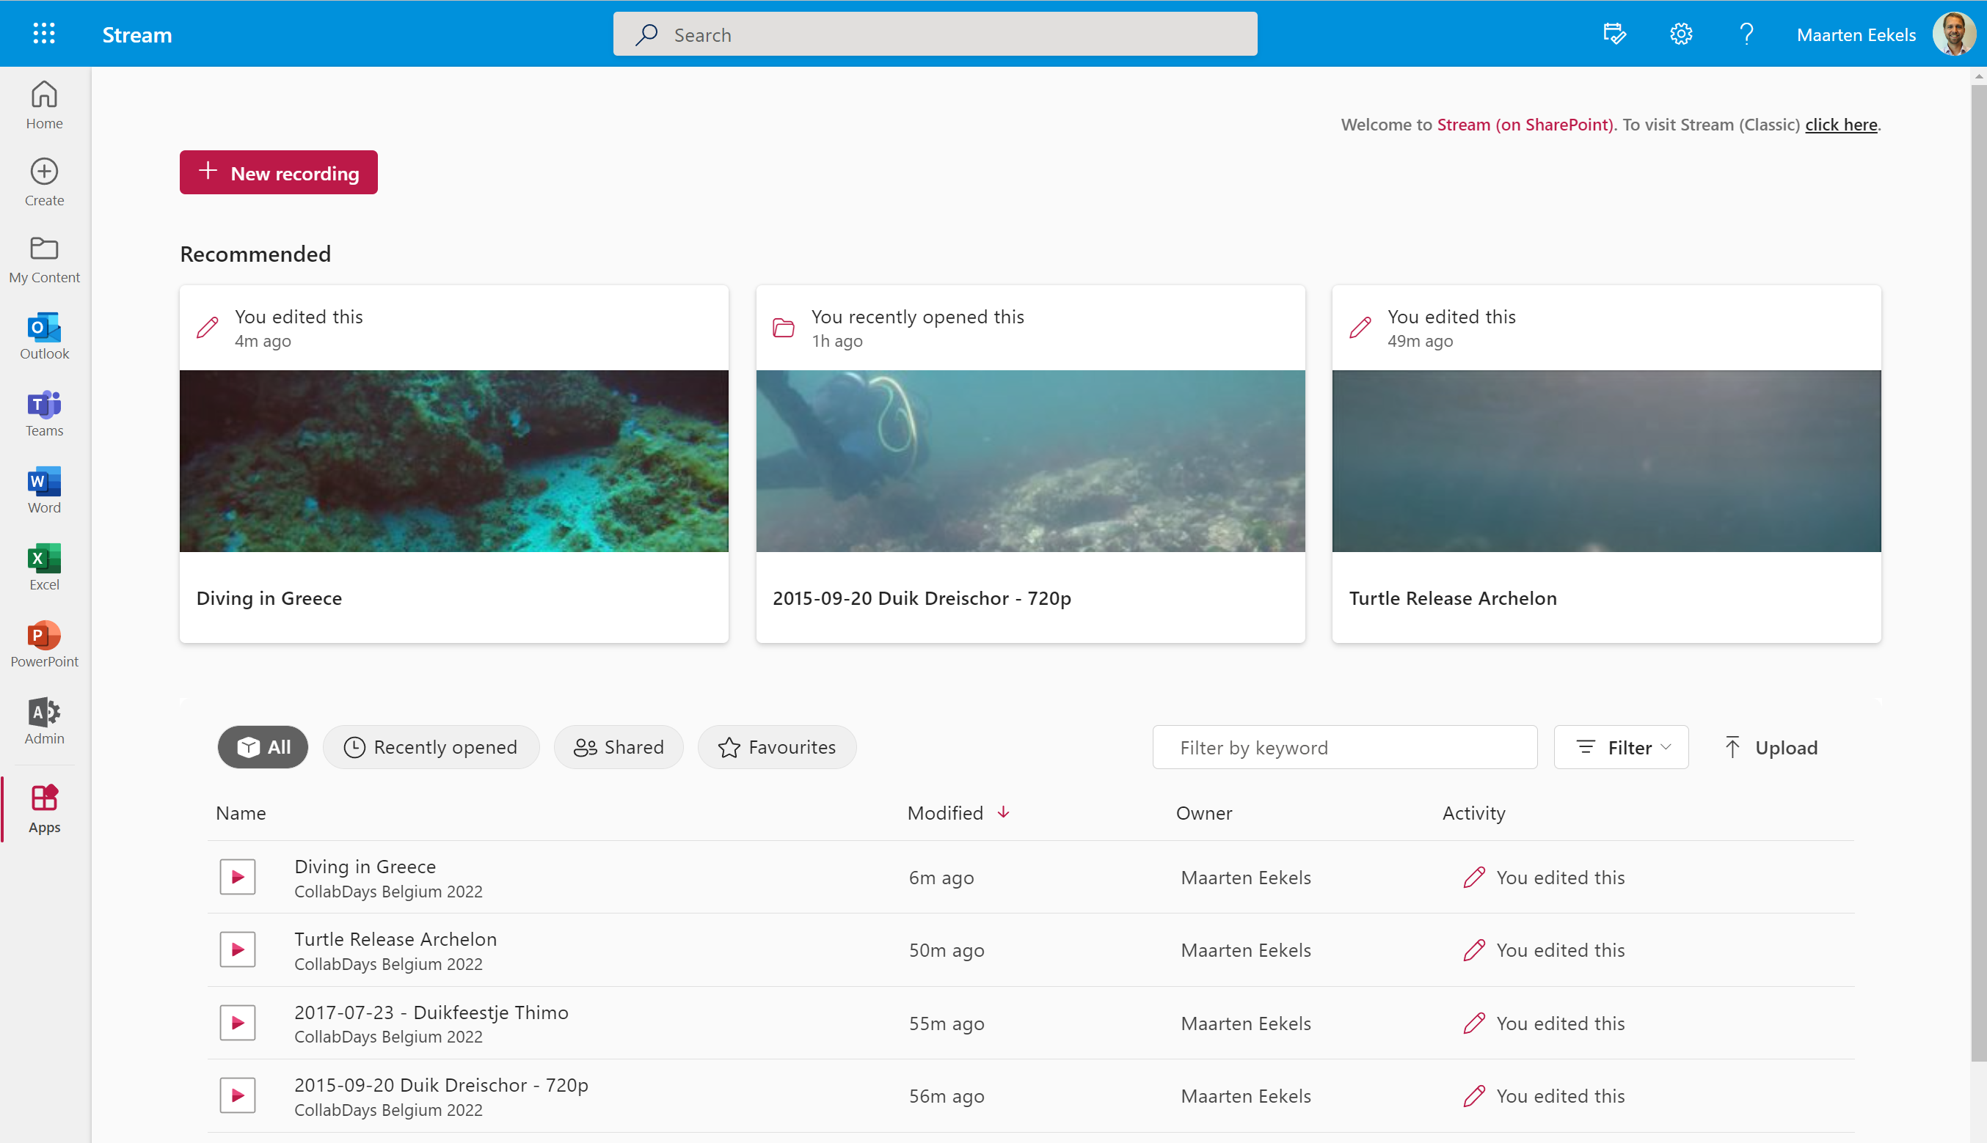

Slide 8
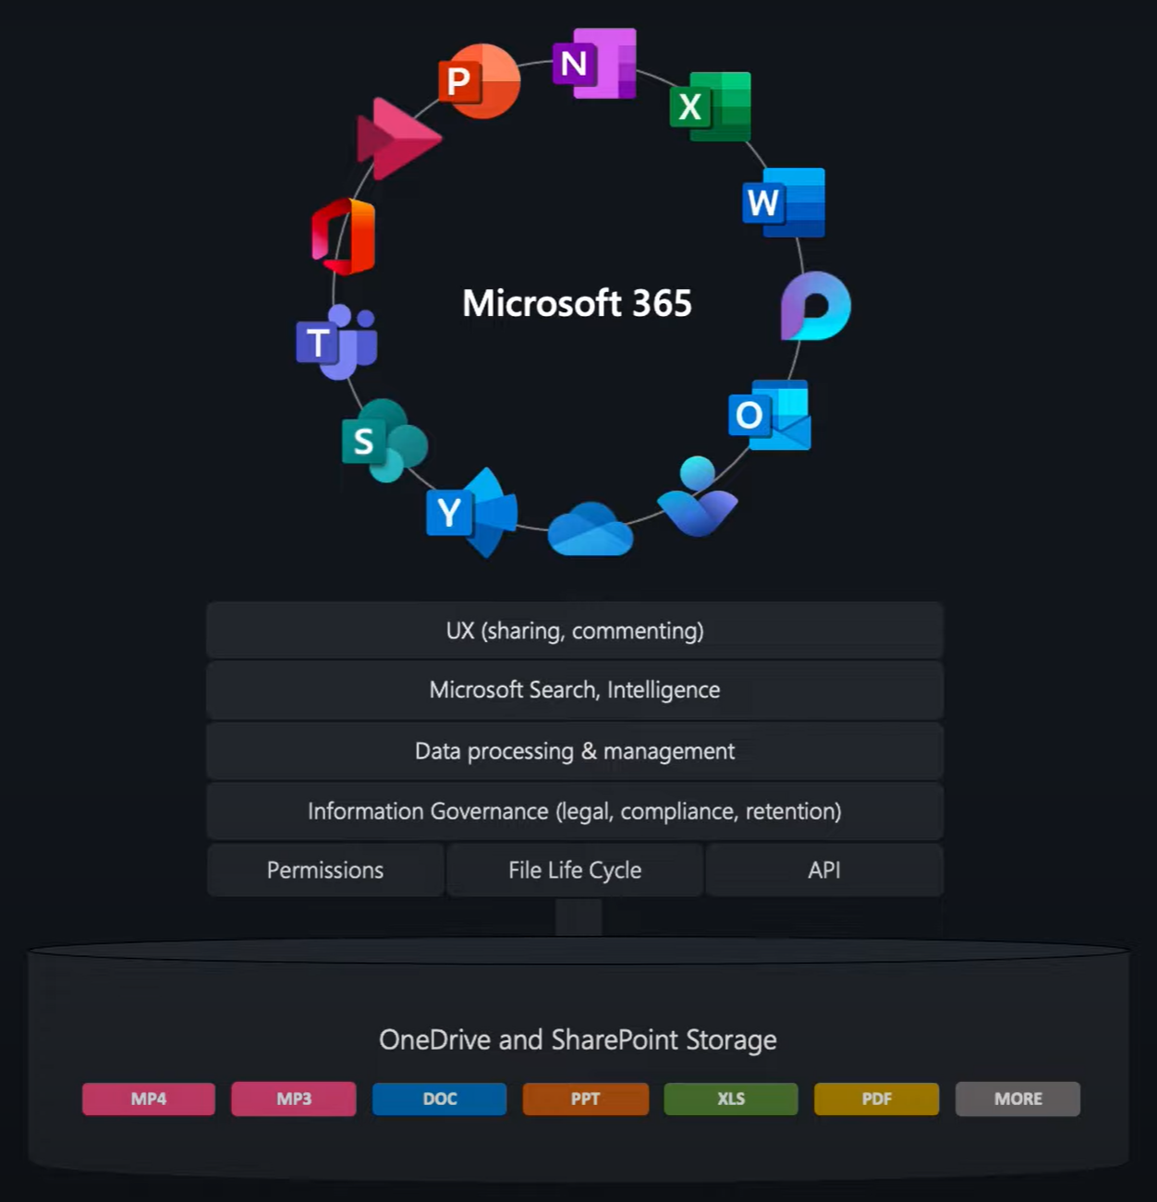




Slide 9
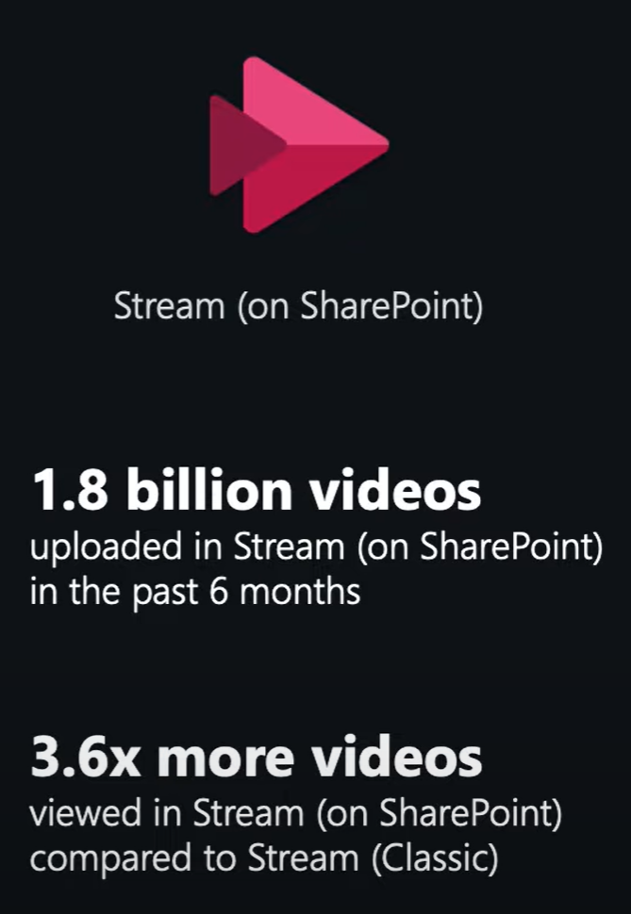

Slide 10
playback
Upload your video files in one of the following formats: 3G2, 3GP, 3GPP, ASF, AVI, M2TS, M4A, M4V, MKV, MOV, MP3, MP4, MP4V, MTS, TS, WAV, WEBM, WMA, WMV
Preferred format: MP4 container with H.264 / MPEG-4 AVC, 1080p, 30 fps, suggested bitrate under 2 Mbps, AAC, 192 Kbps audio
Next, Microsoft caches AES-128 encrypted parts of the video on the Azure Front Door CDN
Hit play and Microsoft takes care of adaptive bitrate streaming on the fly

Slide 11
Demo
Change title
Chapters
Multi language captions and transcripts
Embed code
Video player in Hero web part and other content web parts
Analytics in SharePoint
Video page in Teams
Migration classic to SharePoint

Slide 12
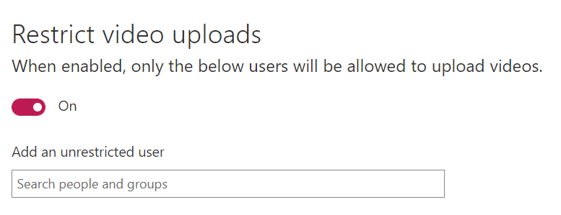
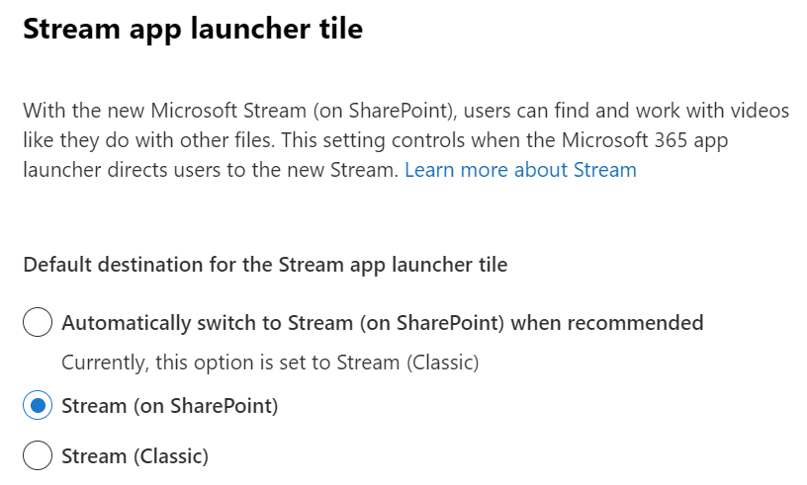
Migration from classic to sharepoint
Inform your co-workers!
Block uploads of new content in Stream Classic
Set message in Stream Classic
Switch Stream icon in app launcher to new Stream (note: this is done in the SharePoint admin center)

Slide 13
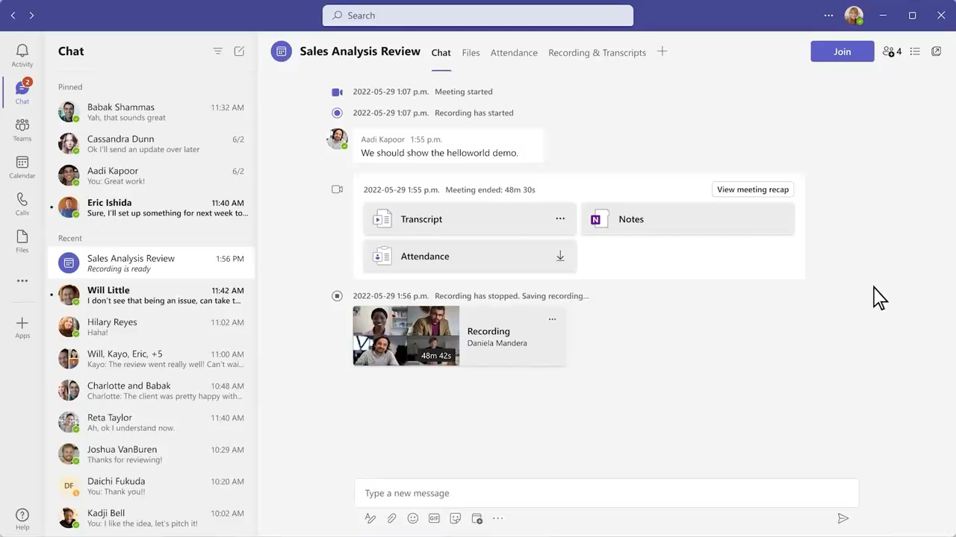

Slide 14
Roadmap + feedback
Microsoft Stream roadmap: https://aka.ms/StreamRoadmapDates
Feedback portal for Microsoft Stream: https://aka.ms/StreamIdeas/
Microsoft Stream Tech Community forum: https://aka.ms/StreamForum

Slide 15


https://collabdays.be
Please rate this session and have a chance to win an awesome prize
#CollabDaysBE

Slide 16

#CollabDaysBE

